Slide 1
Selective Serotonin Reuptake Inhibitors (SSRIs)

Slide 2
Tool 1- Structure Activity Relationship (SAR) Module
Module Design Overview:
The module will be designed as one screen that has 3 clickable tabs at the top, which would say:
1. SAR Requirements
Students will be able to click on the arrows on the compound below or on the letters in the rings
As the student clicks on each spot, the SAR requirement will be displayed next to the compound
2. Drug Class Examples
Drug structures will be displayed with SAR requirements circled or highlighted in corresponding colors with the SAR requirement tab
3. Practice Problems
Format described with each question

Slide 3
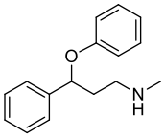
Tool 1- Structure Activity Relationship (SAR) Module
Tab 1: SSRIs SAR requirements
Phenoxyphenylalkyl amines
1. Basic nitrogen→ protonated at physiological pH; pKa 8.7−9.8
2. Electron-withdrawing group → para or meta substitution enhances binding affinity for SERT
Ortho substitution (except CF3) enhances binding affinity for NET and results in NRI
3. Phenoxy→ distinguishes antidepressant and antihistamine activity (derived from diphenhydramine)

Slide 4

Tool 1- Structure Activity Relationship (SAR) Module
Tab 1: SSRIs SAR requirements
Phenylalkyl amines
1. Basic nitrogen→ protonated at physiological pH; pKa 9.5
2. Chlorine→ enhances SERT selectivity

Slide 5
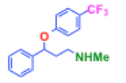
Tool 1- Structure Activity Relationship (SAR) Module
Tab 2: Drug Class Examples
Fluoxetine Sertraline

Slide 6
Tool 1- Structure Activity Relationship (SAR) Module
Tab 3: PRACTICE PROBLEM design- Would the following change to the compound increase or decrease activity?
Have a picture of a compound and then another picture of the compound with one change made
Answer choices: increase or decrease activity
If right answer is selected→ explanation of why the answer is correct is shown next to the compound
If wrong answer is selected→ direct student back to the basic SAR requirement tab for review (no explanation is shown, student must go back and review SAR requirements to move on in the practice problems tab)

Slide 7
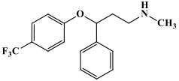
Tool 1- Structure Activity Relationship (SAR) Module
Tab 3: PRACTICE PROBLEM- Would the following change to the compound increase or decrease activity at SERT?
CORRECT ANSWER: DECREASE
The presence of an EWG (CF3) increases SERT activity of phenoxyphenylalkyl amines
Click on either:
INCREASE
OR
DECREASE

Slide 8
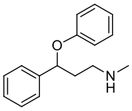
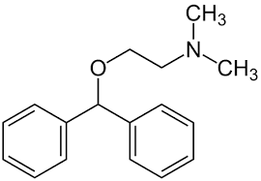
Tool 1- Structure Activity Relationship (SAR) Module
Tab 3: PRACTICE PROBLEM- Would the following change to the compound increase or decrease activity at SERT?
CORRECT ANSWER: INCREASE
The presence of the phenoxy (O directly attached to phenyl ring) distinguishes SSRIs from diphenhydramine
Click on either:
INCREASE
OR
DECREASE

Slide 9
Tool 1- Structure Activity Relationship (SAR) Module
Tab 3: PRACTICE PROBLEM- Would the following change to the compound increase or decrease activity SERT?
Fluoxetine R isomer Fluoxetine S isomer
CORRECT ANSWER: INCREASE
The S isomer of fluoxetine is 100x more selective for SERT
Click on either:
INCREASE
OR
DECREASE

Slide 10
Tool 1- Structure Activity Relationship (SAR) Module
Tab 3: PRACTICE PROBLEM- Would the following change to the compound increase or decrease activity at SERT?
CORRECT ANSWER: DECREASE
Ortho EWG substitution results in NRI and decreases SERT affinity
Cl
Click on either:
INCREASE
OR
DECREASE

Slide 11
Tool 1- Structure Activity Relationship (SAR) Module
Tab 3- PRACTICE PROBLEM design: Which of these 3 antidepressants correctly describes the situation?
Have 3 pictures of different compounds
Student can click any of the 3 compounds
If right compound is selected→ explanation of why the answer is correct is shown
If wrong compound is selected→ direct student back to the basic SAR requirement tab for review (no explanation is shown, student must go back and review SAR requirements to move on in the practice problems tab)

Slide 12
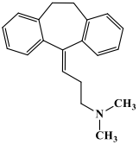
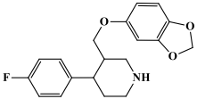
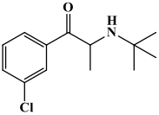
Tool 1- Structure Activity Relationship (SAR) Module
Tab 3- PRACTICE PROBLEM: Which of these 3 antidepressants has major side effects as GI upset and sexual dysfunction? Click on any compound:
CORRECT ANSWER: compound 1 (paroxetine)
Paroxetine is an SSRI, which commonly shows these adverse events

Slide 13
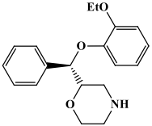
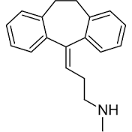
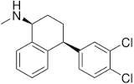
Tool 1- Structure Activity Relationship (SAR) Module
Tab 3- PRACTICE PROBLEM: Which of these 3 antidepressants is most selective for SERT? Click on any compound:
CORRECT ANSWER: compound 3 (sertraline)
Sertraline is an SSRI, which is selective for SERT. Compound 1 is an NRI and compound 2 is a secondary amine TCA, which is more selective for NET.

Slide 14
Tool 1- Structure Activity Relationship (SAR) Module
Tab 3- PRACTICE PROBLEM design: Predict if the metabolites will be active or inactive
Have a picture of a compound with its metabolites
Answer choices for each metabolite: active or inactive
Correct answer will be shown once selected

Slide 15
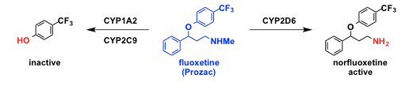
Tool 1- Structure Activity Relationship (SAR) Module
Tab 3: PRACTICE PROBLEM: Predict if the metabolites will be active or inactive
Click either:
Active
or
Inactive?
ANSWER:
Inactive
Click either:
Active
or
Inactive?
ANSWER:
Active

Slide 16
Tool 2-
Module Design Overview:
The module will be designed as one screen, that has fill in the blank statements, with a drop down menu of ~4 possible choices. After all are filled in, the student submit for answers/explanations, and print the completed correct copy for their own studying
1. Mechanism of Action/Indication characteristics
Students will have examples of drug structures from the class on the screen and will know what drug class they are working on
The drop down menu will have possible fill in the blank choices
The goal of the fill in the blanks will to have a summary of where and how the drug class acts, and why it works for its indications
2. Side effects/Contraindications
If there are significant side effects or contraindications to specific drugs in the class or to the drug class in general, these can be addressed as well as statements with blanks to be filled in.

Slide 17
Tool 2 examples
Escitalopram, fluoxetine, sertraline, and citalopram are examples of ________
___________ are the most widely prescribed antidepressants
__________ inhibits CYPs more significantly than _______
Adverse effects include GI and ________________
Notes:
Escitalopram, fluoxetine, sertraline, and citalopram are examples of serotonin reuptake inhibitors
__SSRIs__ are the most widely prescribed antidepressants
_fluoxetine inhibits CYPs more significantly than __(any other SSRI)__
Adverse effects include GI and _sexual side effects ___

Slide 18
Tool 2 examples
SSRI’s have drug drug interactions with _______ and can cause elevated levels of __________
_________ can be recognized with side effects such as increased heart rate and diarrhea
SSRI are (more/less) tolerated than TCA
Abrupt withdrawal can cause ___________
Notes:
SSRI’s have drug drug interactions with MAOIs and can cause elevated levels of serotonin
Serotonin syndrome can be recognized with side effects such as increased heart rate and diarrhea
SSRI are (more/less) tolerated than TCA
Abrupt withdrawal can cause physical dependence

Slide 19
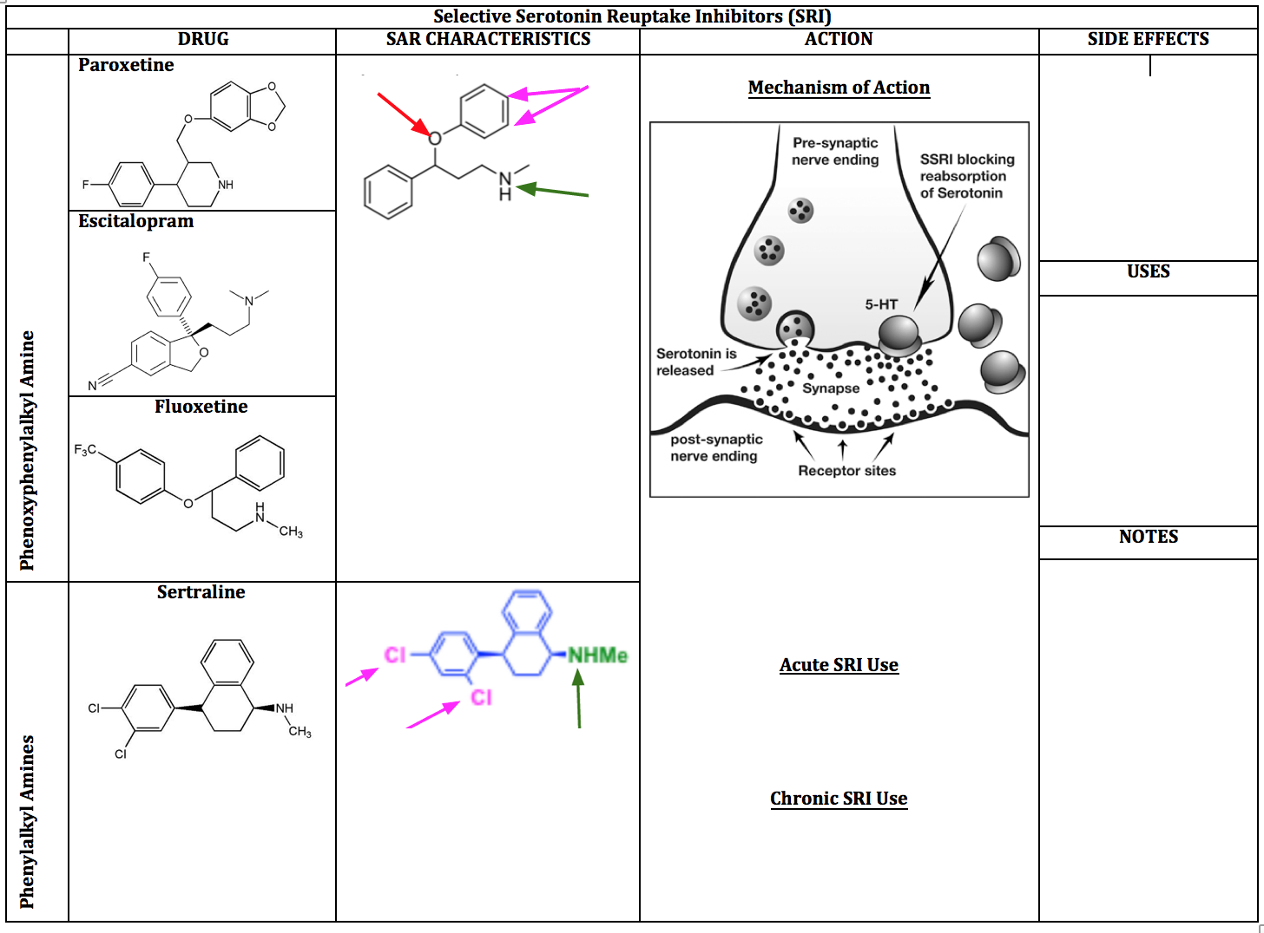
Notes:
SRI table blank

Slide 20
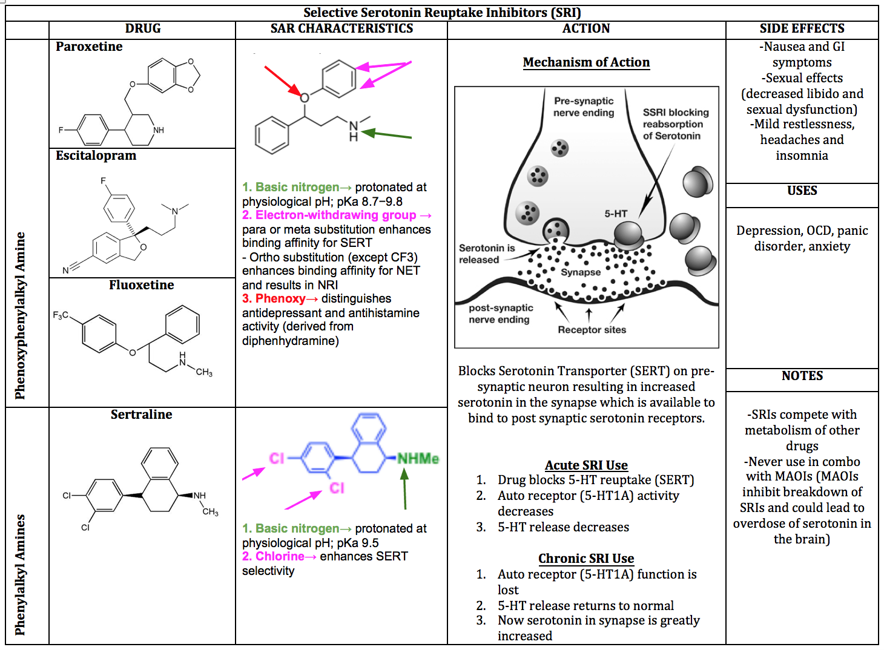
Notes:
SRI Table Complete

Slide 21
Serotonin and Norepinephrine Reuptake Inhibitors (SNRIs)

Slide 22
Tool 1- Structure Activity Relationship (SAR) Module
Module Design Overview:
The module will be designed as one screen that has 2 clickable tabs at the top, which would say:
1. SAR Requirements
Students will be able to click on the arrows on the compound below or on the letters in the rings
As the student clicks on each spot, the SAR requirement will be displayed next to the compound
2. Practice Problems
Format described with each question

Slide 23
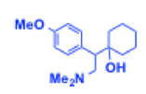
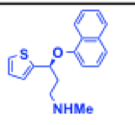
Tool 1- Structure Activity Relationship (SAR) Module
Tab 1: SNRIs SAR requirements
None present
Circled parts of the structure are helpful to associate with this class
Duloxetine Venlafaxine

Slide 24
Tool 1- Structure Activity Relationship (SAR) Module
Tab 2- PRACTICE PROBLEM design: Which of these 3 antidepressants correctly describes the situation?
Have 3 pictures of different compounds
Student can click any of the 3 compounds
If right compound is selected→ explanation of why the answer is correct is shown
If wrong compound is selected→ direct student back to the basic SAR requirement tab for review (no explanation is shown, student must go back and review SAR requirements to move on in the practice problems tab)

Slide 25
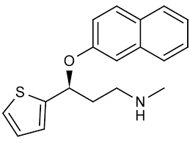
Tool 1- Structure Activity Relationship (SAR) Module
Tab 2- PRACTICE PROBLEM: Which of these 3 antidepressants is active at both SERT and NET? Click on any compound:
CORRECT ANSWER: compound 2 (duloxetine)
Duloxetine is an SNRI, which is active at SERT and NET. Compound 1 is SSRI and Compound 3 is bupropion, which weakly blocks DAT and NET

Slide 26
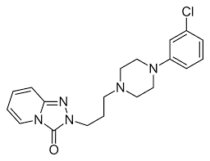
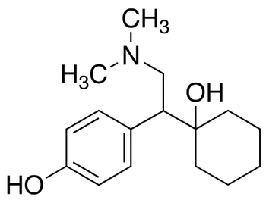
Tool 1- Structure Activity Relationship (SAR) Module
Tab 2- PRACTICE PROBLEM: Which of these 3 antidepressants is considered activating and may raise blood pressure? Click on any compound:
CORRECT ANSWER: compound 3 (venlafaxine)
Duloxetine is an SNRI, which is known to be “activating”

Slide 27
Tool 1- Structure Activity Relationship (SAR) Module
Tab 2: PRACTICE PROBLEM- SAR Clinical Case Study
Present a multi-question case with answer choices given as the compound structure
Student can click any of the 3 compounds
If right compound is selected→ explanation of why the answer is correct is shown
If wrong compound is selected→ direct student back to the beginning of the practice problem

Slide 28
Tool 1- Structure Activity Relationship (SAR) Module
Tab 2- PRACTICE PROBLEM: SAR Clinical Case Study
AH is 80-year old male suffering from depression. He is currently taking paroxetine, but it is not helping.
What one compound would you recommend he try next?
ANSWER: Compound 3 (venlafaxine)
Compound 1 is an SSRI, which he was currently taking and not helping. Compound 2 is a tertiary amine TCA, which acts as a SNRI and would be helpful, but leads to adverse effects such as sedation and hypotension so not recommended in elderly. Compound 3 (venlafaxine) is best choice as it is SNRI, with few adverse effects.

Slide 29
Tool 2-
Module Design Overview:
The module will be designed as one screen, that has fill in the blank statements, with a drop down menu of ~4 possible choices. After all are filled in, the student submit for answers/explanations, and print the completed correct copy for their own studying
1. Mechanism of Action/Indication characteristics
Students will have examples of drug structures from the class on the screen and will know what drug class they are working on
The drop down menu will have possible fill in the blank choices
The goal of the fill in the blanks will to have a summary of where and how the drug class acts, and why it works for its indications
2. Side effects/Contraindications
If there are significant side effects or contraindications to specific drugs in the class or to the drug class in general, these can be addressed as well as statements with blanks to be filled in.

Slide 30
Tool 2 examples
Venlafaxine and duloxetine are examples of ___________
SNRI’s have _________ effects such as agitation
_________ has an active metabolite
(venlafaxine/duloxetine) is more potent than (venlafaxine/duloxetine)
SNRI’s are similar to TCA potency, have (less/more) side effects, and (faster/slower) than SSRI alone

Slide 31
Tool 3-
In combo tool under atypical set

Slide 32
Tricyclic Antidepressants (TCA)

Slide 33
Tool 1- Structure Activity Relationship (SAR) Module
Module Design Overview:
The module will be designed as one screen that has 3 clickable tabs at the top, which would say:
1. SAR Requirements
Students will be able to click on the arrows on the compound below or on the letters in the rings
As the student clicks on each spot, the SAR requirement will be displayed next to the compound
2. Drug Class Examples
Drug structures will be displayed with SAR requirements circled or highlighted in corresponding colors with the SAR requirement tab
3. Practice Problems
Format described with each question

Slide 34
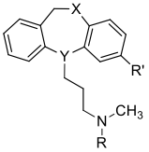
Tool 1- Structure Activity Relationship (SAR) Module
Tab 1: TCA SAR requirements
Tertiary amines
1. Linker of 3 carbons between tricyclic ring system and basic nitrogen
Branching from linker decreases binding affinity for SERT and NET
Unsaturation of linker is tolerated
2. R→ CH3, tertiary amine imparts selectivity for SERT
3. R’→ Cl or CN (EWG) enhances binding affinity for SERT
4. Y→ can be C or N
5. Conformationally rigid [6.7.6]-fused ring system
7 membered ring in the middle is not coplanar; results in twisted shape

Slide 35
Tool 1- Structure Activity Relationship (SAR) Module
Tab 1: TCA SAR requirements
Secondary amines
1. Linker of 3 carbons between tricyclic ring system and basic nitrogen
Branching from linker decreases binding affinity for SERT and NET
Unsaturation of linker is tolerated
2. R→ H, secondary amine imparts selectivity for NET
3. R’→ no substitution decreases SERT preference
4. Y→ can be C or N
5. Conformationally rigid [6.7.6]-fused ring system
7 membered ring in the middle is not coplanar; results in twisted shape

Slide 36
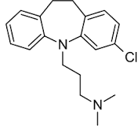
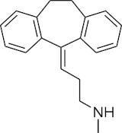
Tool 1- Structure Activity Relationship (SAR) Module
Tab 2: Drug Class Examples
Clomipramine Nortriptyline

Slide 37
Tool 1- Structure Activity Relationship (SAR) Module
Tab 3: PRACTICE PROBLEM design- Would the following change to the compound increase or decrease activity?
Have a picture of a compound and then another picture of the compound with one change made
Answer choices: increase or decrease activity
If right answer is selected→ explanation of why the answer is correct is shown next to the compound
If wrong answer is selected→ direct student back to the basic SAR requirement tab for review (no explanation is shown, student must go back and review SAR requirements to move on in the practice problems tab)

Slide 38
Tool 1- Structure Activity Relationship (SAR) Module
Tab 3: PRACTICE PROBLEM- Would the following change to the compound increase or decrease activity at SERT?
CORRECT ANSWER: DECREASE
Tertiary→ Secondary amine decreases binding affinity for SERT
Click on either:
INCREASE
OR
DECREASE
H

Slide 39
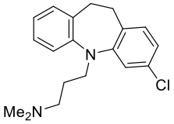
Tool 1- Structure Activity Relationship (SAR) Module
Tab 3: PRACTICE PROBLEM- Would the following change to the compound increase or decrease activity at SERT?
CORRECT ANSWER: INCREASE
Presence of EWG (Cl) enhances binding affinity for SERT
Click on either:
INCREASE
OR
DECREASE

Slide 40
Tool 1- Structure Activity Relationship (SAR) Module
Tab 2- PRACTICE PROBLEM design: Which of these 3 antidepressants correctly describes the situation?
Have 3 pictures of different compounds
Student can click any of the 3 compounds
If right compound is selected→ explanation of why the answer is correct is shown
If wrong compound is selected→ direct student back to the basic SAR requirement tab for review (no explanation is shown, student must go back and review SAR requirements to move on in the practice problems tab)

Slide 41
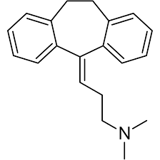
Tool 1- Structure Activity Relationship (SAR) Module
Tab 2- PRACTICE PROBLEM: Which of these 3 antidepressants is active at both SERT and NET? Click on any compound:
CORRECT ANSWER: compound 2 (amitriptyline)
Compound 2, amitriptyline is a tertiary TCA, which is active at SERT and NET. Compound 1 is SSRI and Compound 3 is a secondary TCA, only active at NET

Slide 42
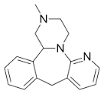
Tool 1- Structure Activity Relationship (SAR) Module
Tab 2- PRACTICE PROBLEM: Which of these 3 antidepressants causes significant dry mouth, constipation, and sedation? Click on any compound:
CORRECT ANSWER: compound 1 (Clomipramine)
Compound 1, clomipramine is a tertiary TCA, which is can bind to muscarinic and histamine receptors resulting in off target adverse effects. Compound 2 is a SSRI and does not cause these adverse effects. Compound 3 is a mirtazepine and while it can cause sedation, it does not display anticholinergic effects such as dry mouth and constipation.

Slide 43
Tool 1- Structure Activity Relationship (SAR) Module
Tab 3- PRACTICE PROBLEM design: Predict if the metabolites will be active or inactive
Have a picture of a compound with its metabolites
Answer choices for each metabolite: active or inactive
Correct answer will be shown once selected

Slide 44

Tool 1- Structure Activity Relationship (SAR) Module
Tab 3: PRACTICE PROBLEM- Predict if the metabolites will be active or inactive
Click either:
Active
or
Inactive?
ANSWER:
Active
Click either:
Active
or
Inactive?
ANSWER:
Inactive
Would this be an ideal antidepressant for the elderly? (click either: YES or NO)
ANSWER: NO, causes anticholinergic effects

Slide 45
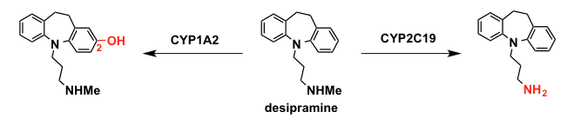
Tool 1- Structure Activity Relationship (SAR) Module
Tab 3: PRACTICE PROBLEM- Predict if the metabolites will be active or inactive
Click either:
Active
or
Inactive?
ANSWER:
Active
Click either:
Active
or
Inactive?
ANSWER:
Inactive

Slide 46
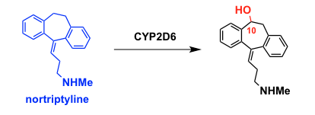
Tool 1- Structure Activity Relationship (SAR) Module
Tab 3: PRACTICE PROBLEM- Predict if the metabolites will be active or inactive
Click either:
Active
or
Inactive?
ANSWER:
Inactive
Is this compound considered an SNRI or NRI? (click either)
ANSWER: NRI

Slide 47
Tool 2-
Module Design Overview:
The module will be designed as one screen, that has fill in the blank statements, with a drop down menu of ~4 possible choices. After all are filled in, the student submit for answers/explanations, and print the completed correct copy for their own studying
1. Mechanism of Action/Indication characteristics
Students will have examples of drug structures from the class on the screen and will know what drug class they are working on
The drop down menu will have possible fill in the blank choices
The goal of the fill in the blanks will to have a summary of where and how the drug class acts, and why it works for its indications
2. Side effects/Contraindications
If there are significant side effects or contraindications to specific drugs in the class or to the drug class in general, these can be addressed as well as statements with blanks to be filled in.

Slide 48
Tool 2 examples
Tertiary TCAs have slightly greater selectivity for blockade of (Norepinephrine/Serotonin) reuptake over (Norepinephrine/Serotonin) reuptake
Secondary TCA’s, such as (nortriptyline/amitriptyline) have greater selectivity for blockade of (Norepinephrine/Serotonin)
TCA adverse effects include _____________ effects such as dry eyes and mouth
Onset of action for TCA’s takes 2-3 (weeks/days)
Side effects include sexual dysfunction, constipation, and ________
Notes:
Tertiary TCAs have slightly greater selectivity for blockade of (Norepinephrine/Serotonin) reuptake over (Norepinephrine/Serotonin) reuptake
Secondary TCA’s, such as (nortriptyline/amitriptyline) have greater selectivity for blockade of (Norepinephrine/Serotonin)
TCA adverse effects include antimuscarinic effects such as dry eyes and mouth
Onset of action for TCA’s takes 2-3 (weeks/days)
Sedation

Slide 49
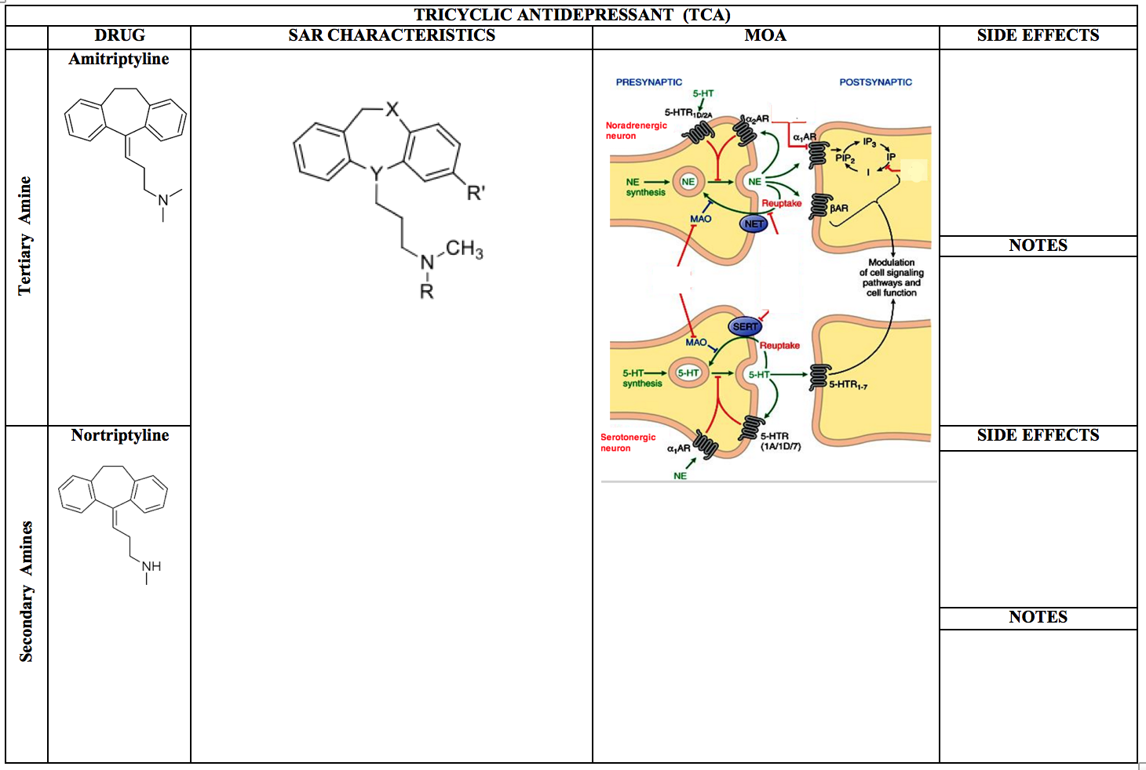
Tool 3-
Notes:
Blank TCA sheet

Slide 50
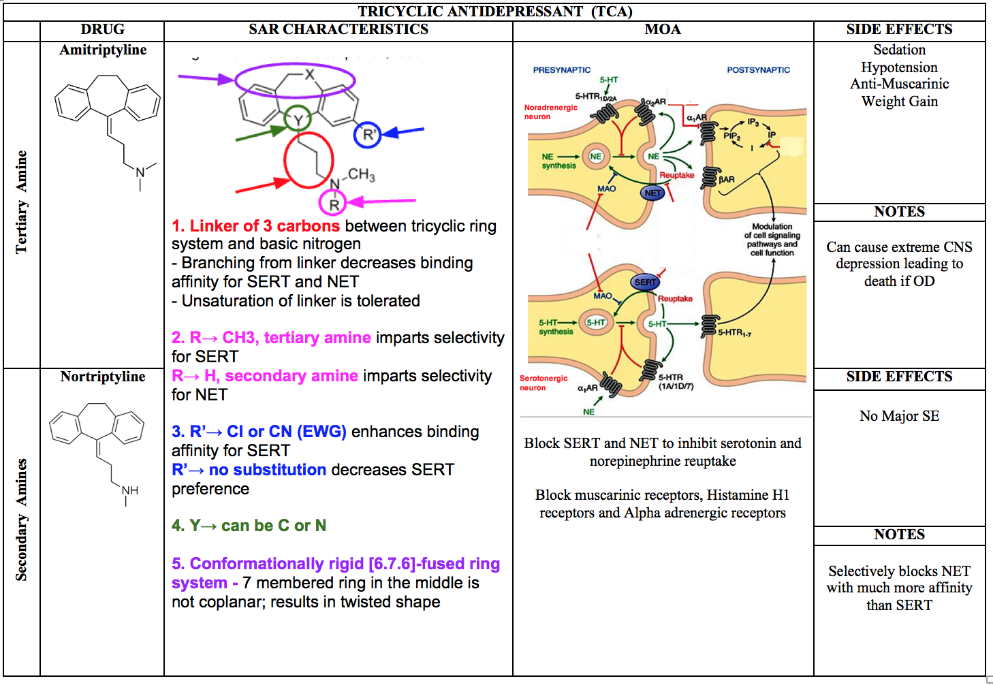
Notes:
Complete TCA sheet

Slide 51
Atypical Antidepressants

Slide 52
Tool 1- Structure Activity Relationship (SAR) Module
Module Design Overview:
The module will be designed as one screen that has 2 clickable tabs at the top, which would say:
1. SAR Requirements
Students will be able to click on the arrows on the compound below or on the letters in the rings
As the student clicks on each spot, the SAR requirement will be displayed next to the compound
2. Practice Problems
Format described with each question

Slide 53
Tool 1- Structure Activity Relationship (SAR) Module
Tab 1: SAR Requirements:
None present
Circled parts of each structure are helpful to associate with the compounds
Trazodone Mirtazapine Bupropion

Slide 54
Tool 1- Structure Activity Relationship (SAR) Module
Tab 2- PRACTICE PROBLEM design: Which of these 3 antidepressants correctly describes the situation?
Have 3 pictures of different compounds
Student can click any of the 3 compounds
If right compound is selected→ explanation of why the answer is correct is shown
If wrong compound is selected→ direct student back to the basic SAR requirement tab for review (no explanation is shown, student must go back and review SAR requirements to move on in the practice problems tab)

Slide 55
Tool 1- Structure Activity Relationship (SAR) Module
Tab 2- PRACTICE PROBLEM: Which of these 3 antidepressants can also be used for smoking cessation? Click on any compound:
CORRECT ANSWER: compound 2 (bupropion)

Slide 56
Tool 1- Structure Activity Relationship (SAR) Module
Tab 2- PRACTICE PROBLEM: Which of these 3 antidepressants causes sedation by blocking histamine receptors? Click on any compound:
CORRECT ANSWER: compound 3 (mirtazepine)

Slide 57
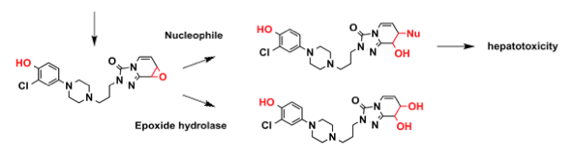
Tool 1- Structure Activity Relationship (SAR) Module
Tab 2- PRACTICE PROBLEM: Which of these 3 antidepressants can result in a hepatotoxic metabolite? Click on any compound:
CORRECT ANSWER: compound 2 (trazodone)
Metabolism of trazodone will be displayed for the student, if correct answer chosen

Slide 58
Tool 1- Structure Activity Relationship (SAR) Module
Tab 2: PRACTICE PROBLEM- SAR Clinical Case Study
Present a multi-question case with answer choices given as the compound structure
Student can click any of the 3 compounds
If right compound is selected→ explanation of why the answer is correct is shown
If wrong compound is selected→ direct student back to the beginning of the practice problem

Slide 59
Tool 1- Structure Activity Relationship (SAR) Module
Tab 2- PRACTICE PROBLEM: SAR Clinical Case Study
TD is 25-year old female suffering from depression. She complains of feeling tired and gaining weight with her last course of antidepressants.
Which compound would you recommend her to try?
ANSWER: Compound 3 (Bupropion)
Compound 1 trazodone can cause sedation. Compound 2 amitriptyline can cause weight gain. Compound 3 bupropion would be a good alternative for this patient to prevent unwanted adverse effects.

Slide 60
Tool 2-
Module Design Overview:
The module will be designed as one screen, that has fill in the blank statements, with a drop down menu of ~4 possible choices. After all are filled in, the student submit for answers/explanations, and print the completed correct copy for their own studying
1. Mechanism of Action/Indication characteristics
Students will have examples of drug structures from the class on the screen and will know what drug class they are working on
The drop down menu will have possible fill in the blank choices
The goal of the fill in the blanks will to have a summary of where and how the drug class acts, and why it works for its indications
2. Side effects/Contraindications
If there are significant side effects or contraindications to specific drugs in the class or to the drug class in general, these can be addressed as well as statements with blanks to be filled in.

Slide 61
Tool 2 examples
Significant side effect of both trazodone and mirtazepine is ________
Trazodone works by blocking the ______ serotonin receptor and being an agonist at the _______ serotonin receptor
Mirtazapine blocks a serotonin receptor and a ________ receptor
Buproprion has a potential for ___________ at high doses
__________ can cause increase appetite and weight gain while ___________ can have the opposite effect
______________ can be used a sleep aid independent of its antidepressant activity
Notes:
Significant side effect of both trazodone and mirtazepine is sedation
Trazodone works by blocking the 5HT2A serotonin receptor and being an agonist at the 5HT1A serotonin receptor
Mirtazapine blocks a serotonin receptor and a histamine receptor
Buproprion has a potential for seizures at high doses
trazodone can cause increase appetite and weight gain while bupropion can have the opposite effect
Trazodone can be used a sleep aid independent of its antidepressant activity

Slide 62
Tool 3-

Slide 63
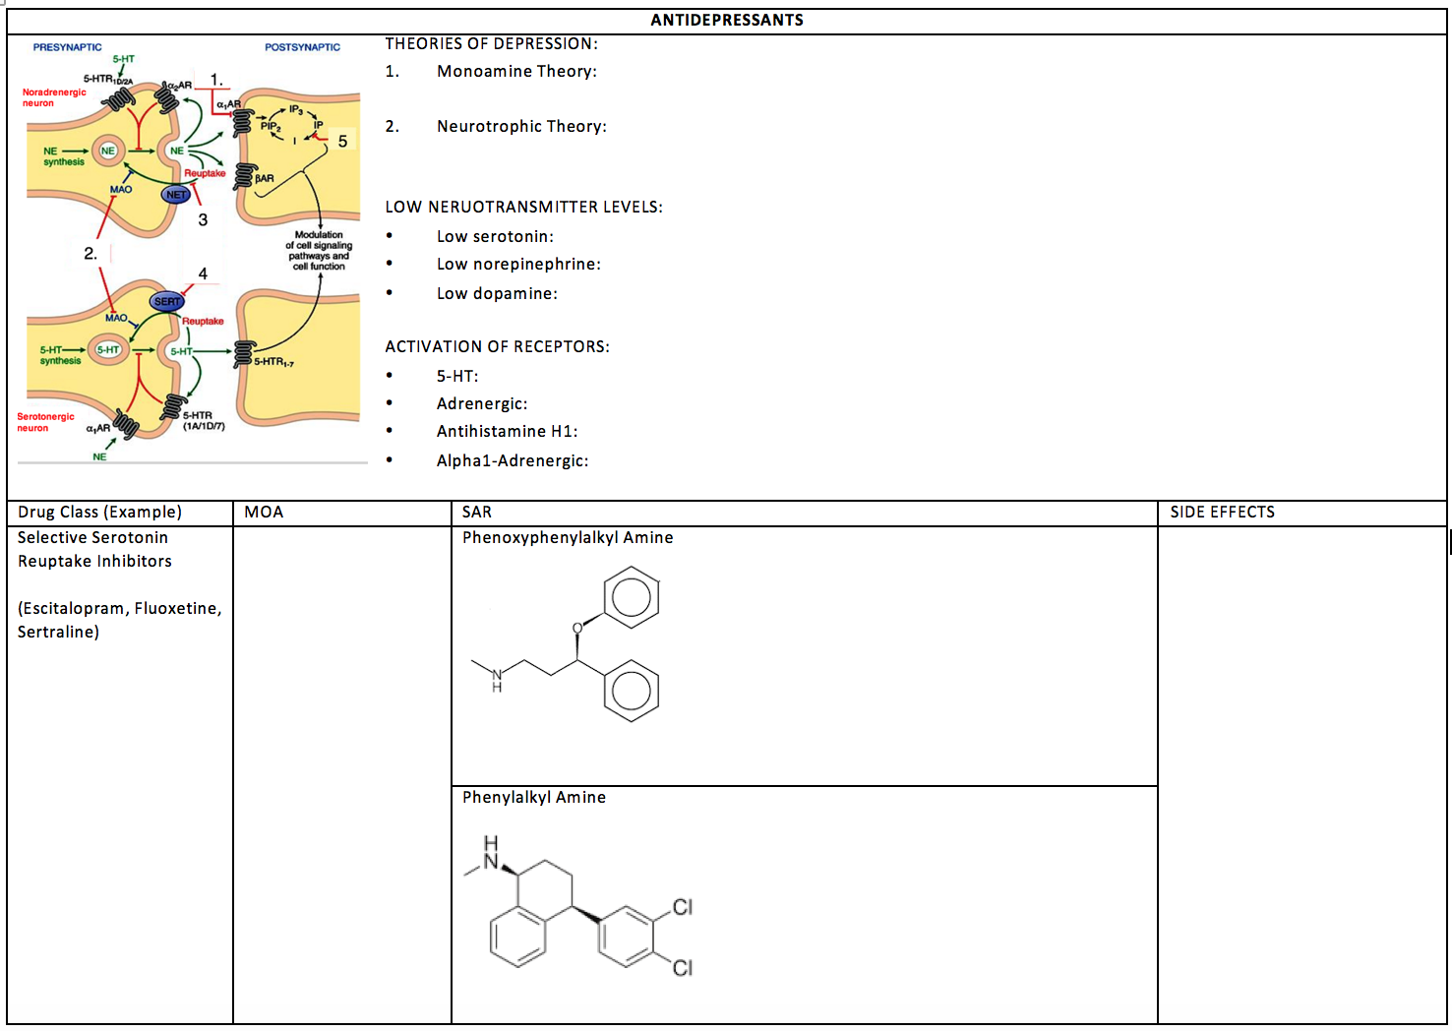
Tool 3
Notes:
Combined antidepressant blank page 1

Slide 64
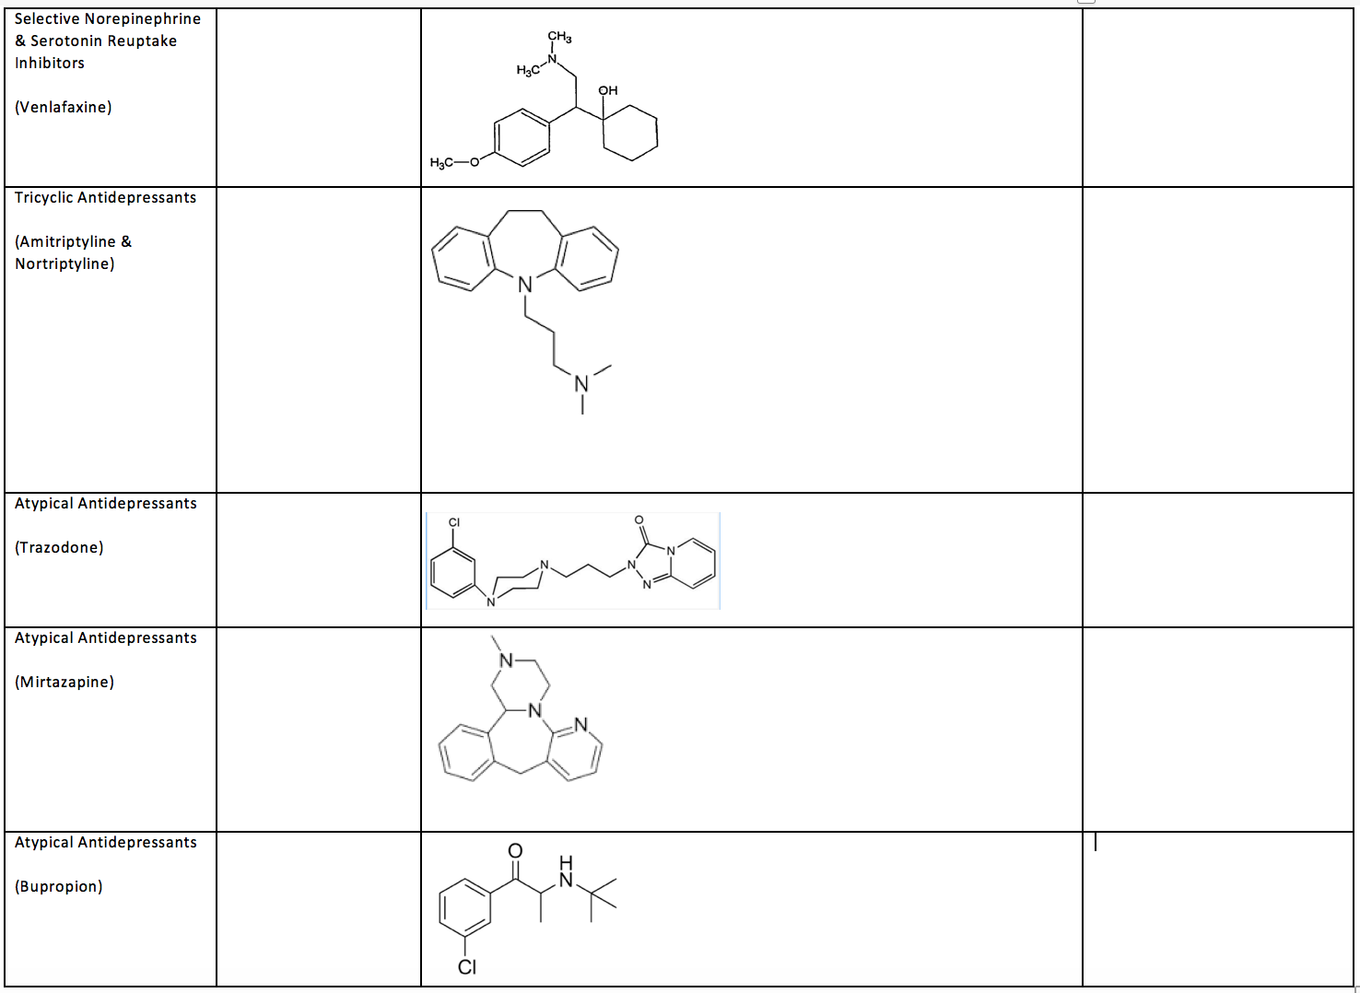
Notes:
Combined antidepressant blank page 2

Slide 65
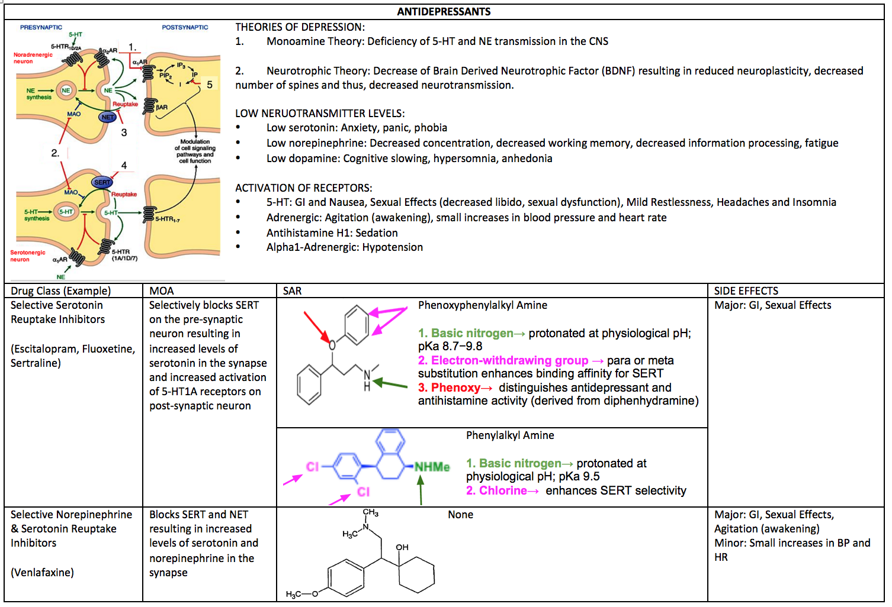
Notes:
Combined antidepressant complete page 1

Slide 66
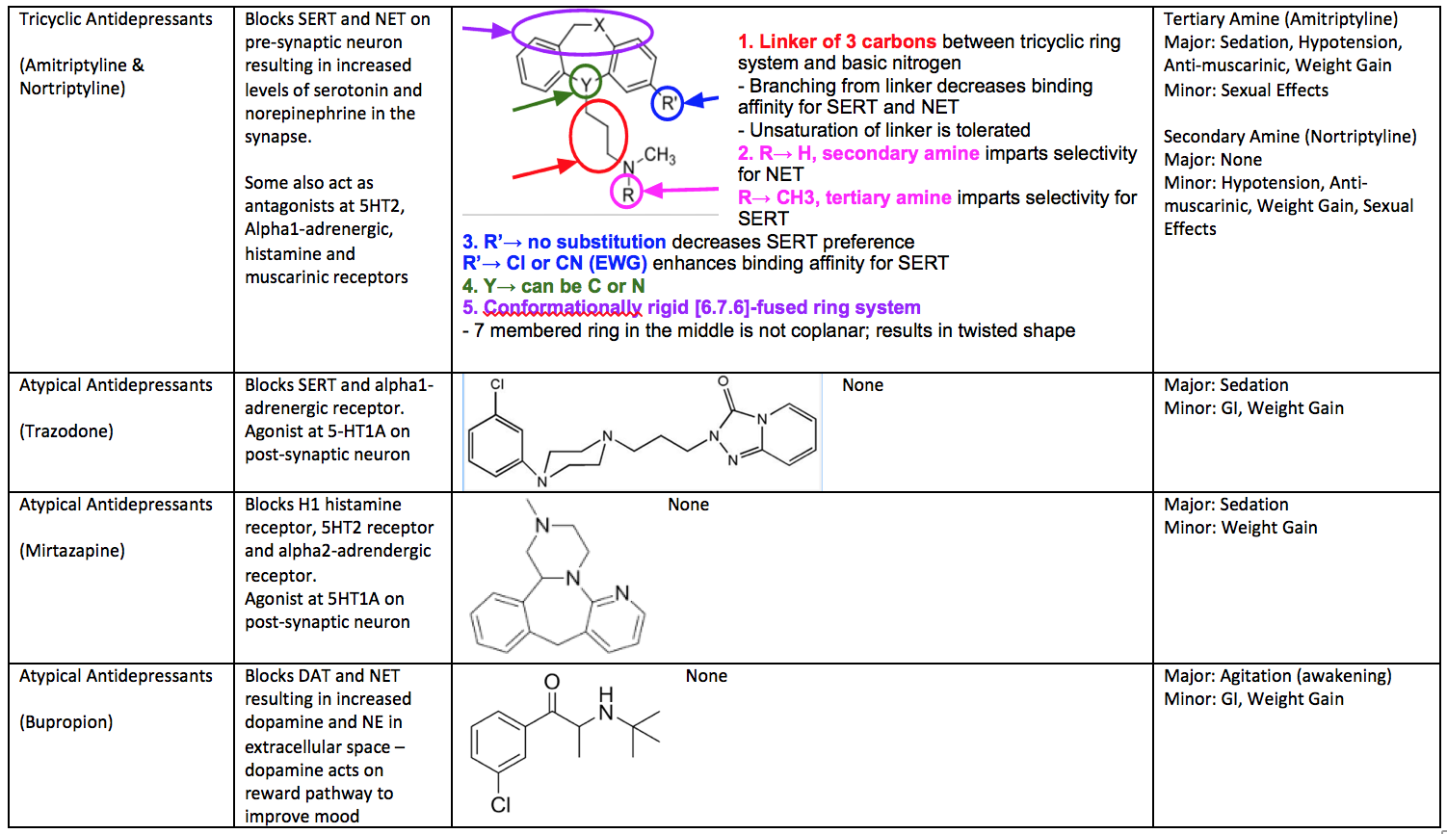
Notes:
Combined antidepressant complete page 1

